Slide 1
Analog Transmission

Slide 2
Modulation
Modulation can be digital or analog. Input wave of analog scheme varies continuously like a sine wave.
Voice is sampled at some rate then compressed and turned into a bit-stream then superimposed on the carrier signal, in digital modulation.
This all happens because the communication systems have used a powerful and beautiful technique called Modulation

Slide 3
Modulation
The process by which data/information is converted into electrical/digital signals for transferring that signal over a medium is called modulation.
It increases strength for maximum reach of the signals. The process of extracting information/data from the transmitted signal is called demodulation.

Slide 4















































Analog-to-Analog
Analog-to-analog conversion is the representation of analog information by an analog signal. One may ask why we need to modulate an analog signal; it is already analog. Modulation is needed if the medium is bandpass in nature or if only a bandpass channel is available to us.
Topics discussed in this section:
Amplitude Modulation
Frequency Modulation
Phase Modulation

Slide 5
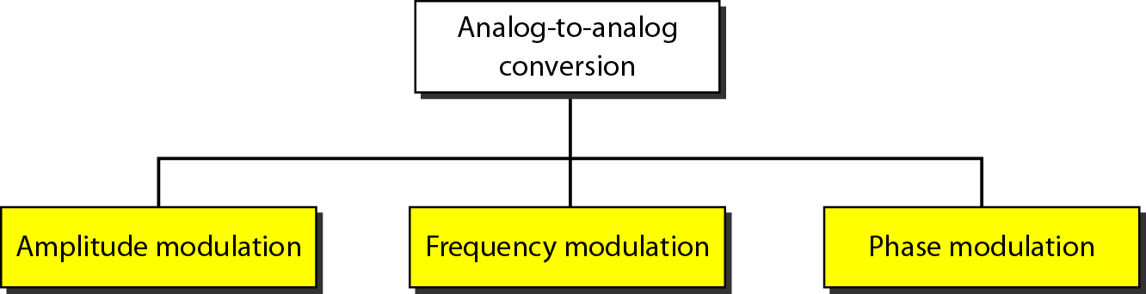
Figure 5.15 Types of analog-to-analog modulation

Slide 6
Analog-to-Analog Modulation
The various forms of modulation are designed to alter the characteristic of carrier waves.
The most commonly altered characteristics of modulation include amplitude, frequency, and phase.
Carrier signal: The signals which contain no information but have a certain phase, frequency, and amplitude are called carrier signals.
Modulated signals: The signals which are the combination of the carrier signals and modulation signals are modulated signals. The modulated signal is obtained after the modulation of the signals.

Slide 7
Amplitude Modulation
It is a type of modulation in which only the amplitude of the carrier signal is varied to represent the data being added to the signals whereas the phase and the frequency of the signal are kept unchanged.
The required bandwidth is 2B, where B is the bandwidth of the modulating signal.
Since on both sides of the carrier freq. f_{c}, the spectrum is identical, we can discard one half, thus requiring a smaller bandwidth for transmission

Slide 8
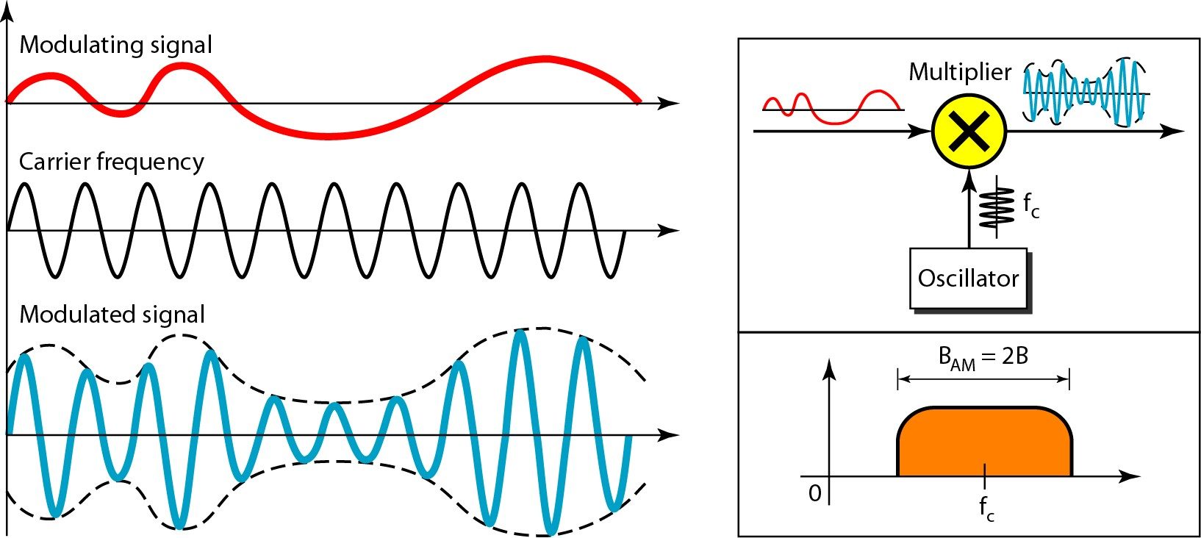
Figure 5.16 Amplitude modulation

Slide 9
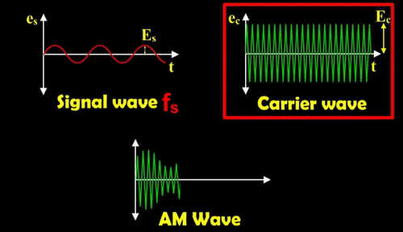
Amplitude Modulation

Slide 10
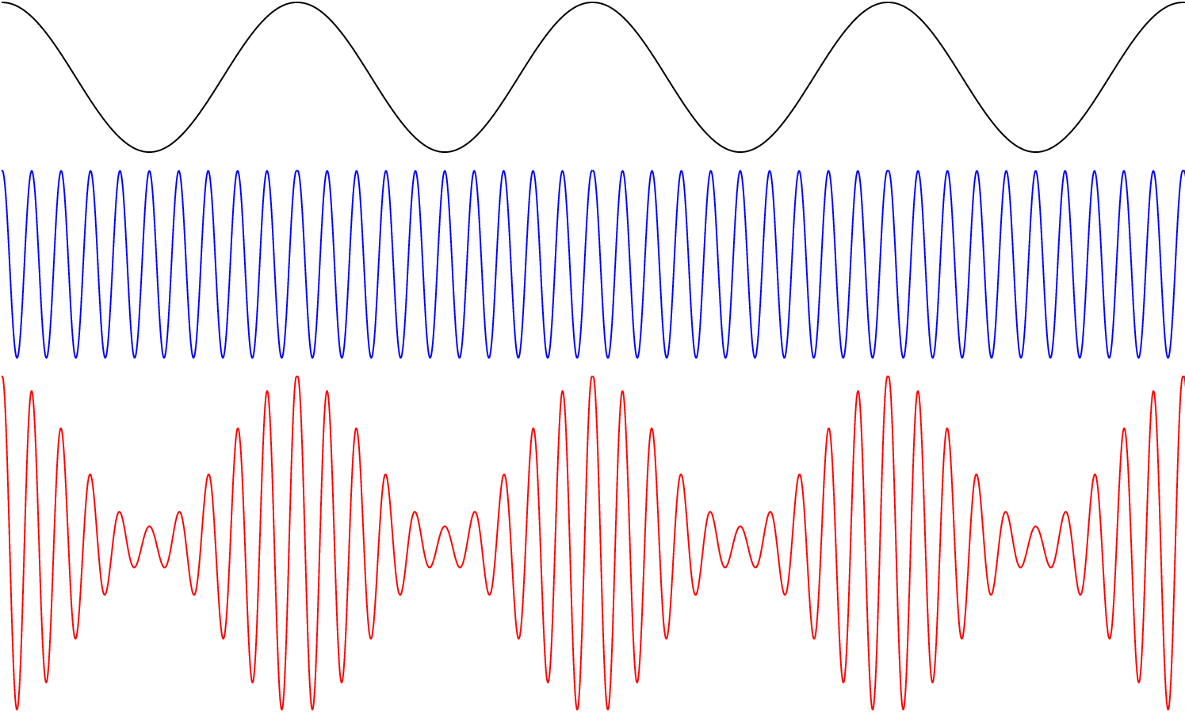
Amplitude Modulation

Slide 11




Note
The total bandwidth required for AM can be determined
from the bandwidth of the audio signal: B_{AM} = 2B.

Slide 12
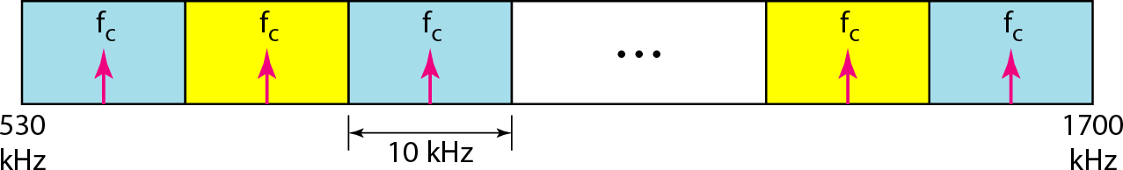
Figure 5.17 AM band allocation

Slide 13
Frequency modulation
It is a type of modulation in which only the frequency of the carrier signal is varied to represent the frequency of the data whereas the phase and the amplitude of the signals are kept unchanged.

Slide 14
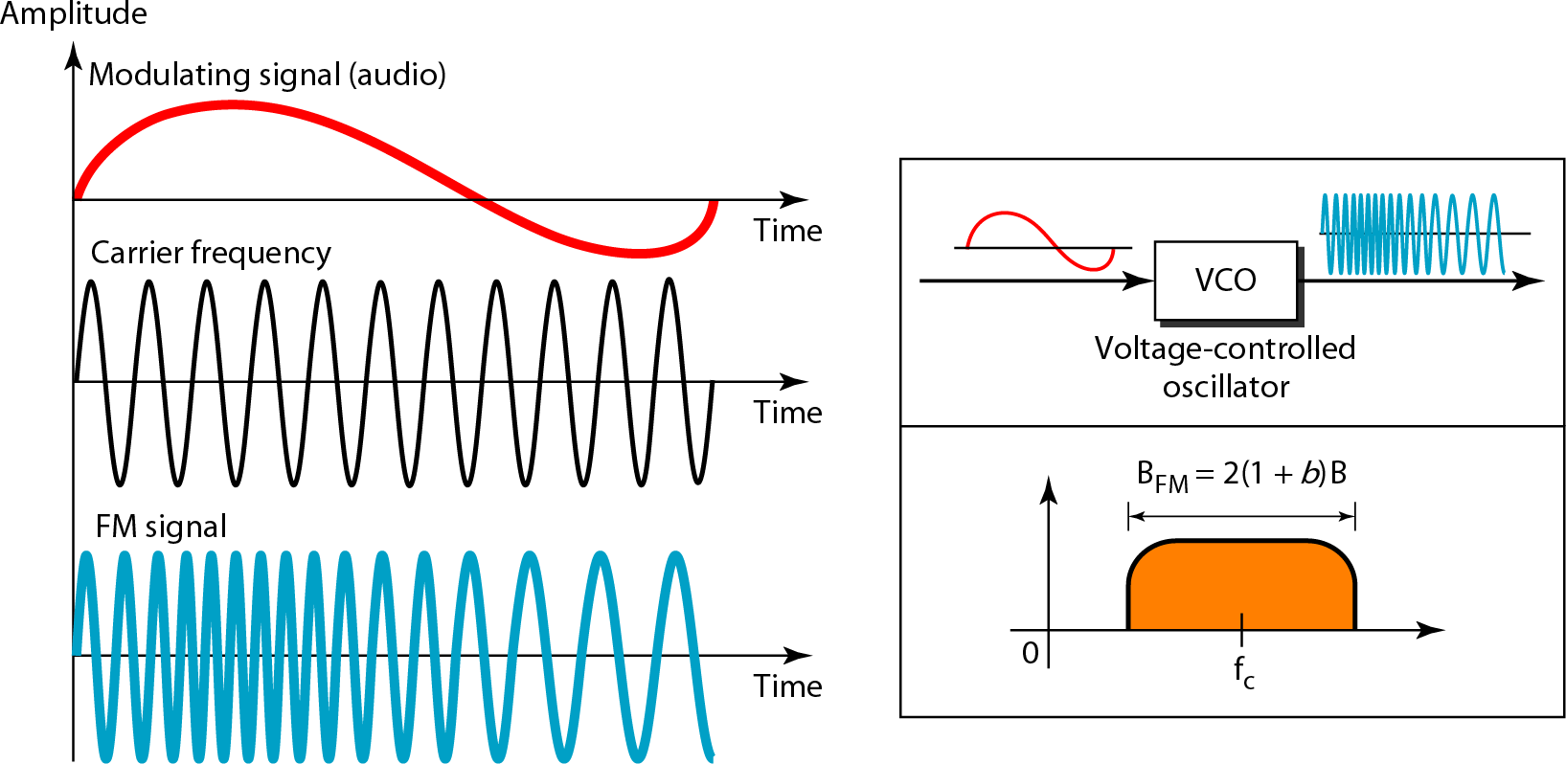
Figure 5.18 Frequency modulation

Slide 15
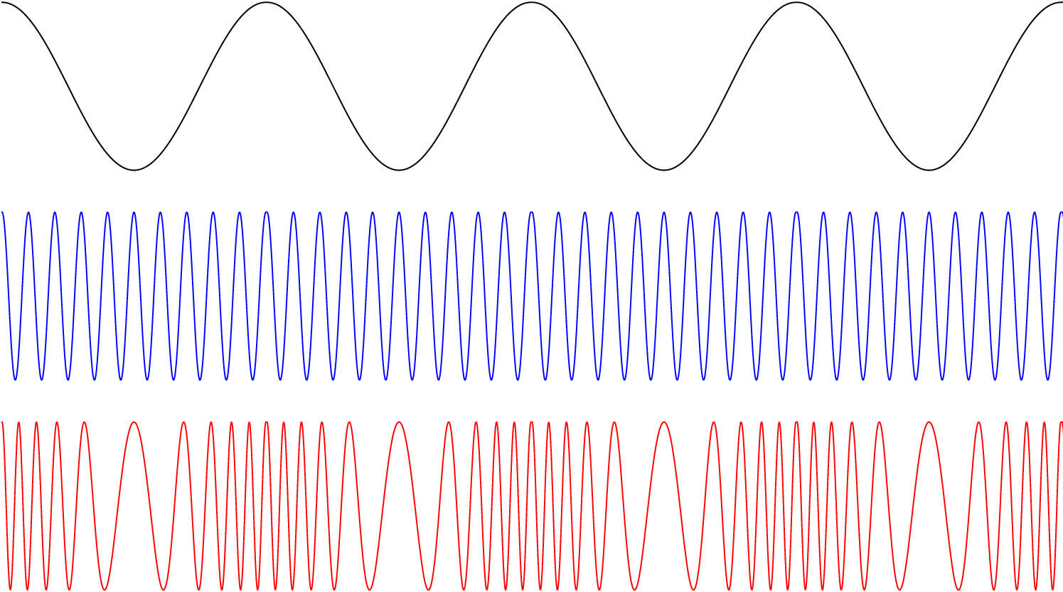
Frequency modulation

Slide 16


Note
The total bandwidth required for FM can be determined from the bandwidth
of the audio signal: B_{FM} = 2(1 + β)B. Where β is usually 4.

Slide 17
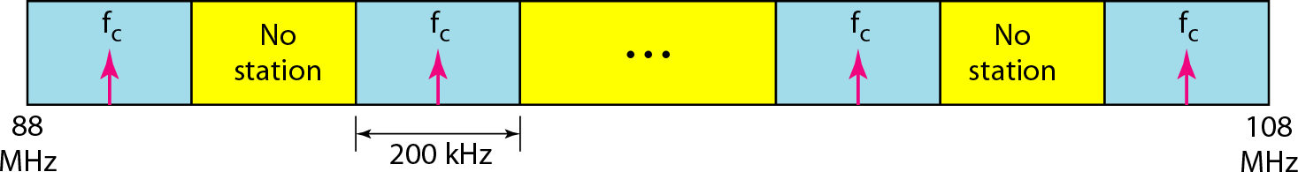
Figure 5.19 FM band allocation

Slide 18
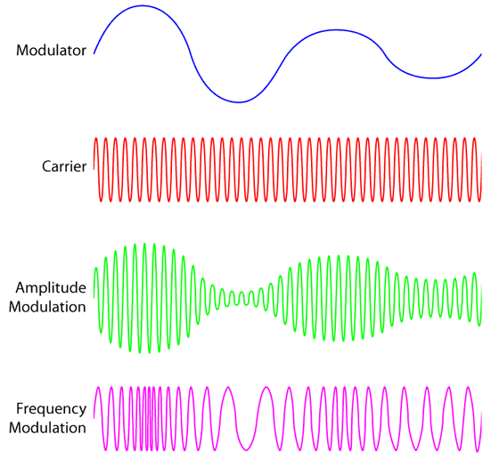
Amplitude VS Frequency modulation

Slide 19
Phase Modulation (PM)
The modulating signal only changes the phase of the carrier signal.
The phase change manifests itself as a frequency change but the instantaneous frequency change is proportional to the derivative of the amplitude.
The bandwidth is higher than for AM.

Slide 20
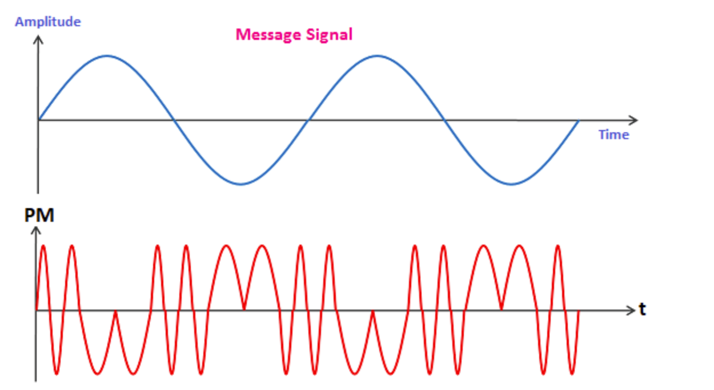

Slide 21
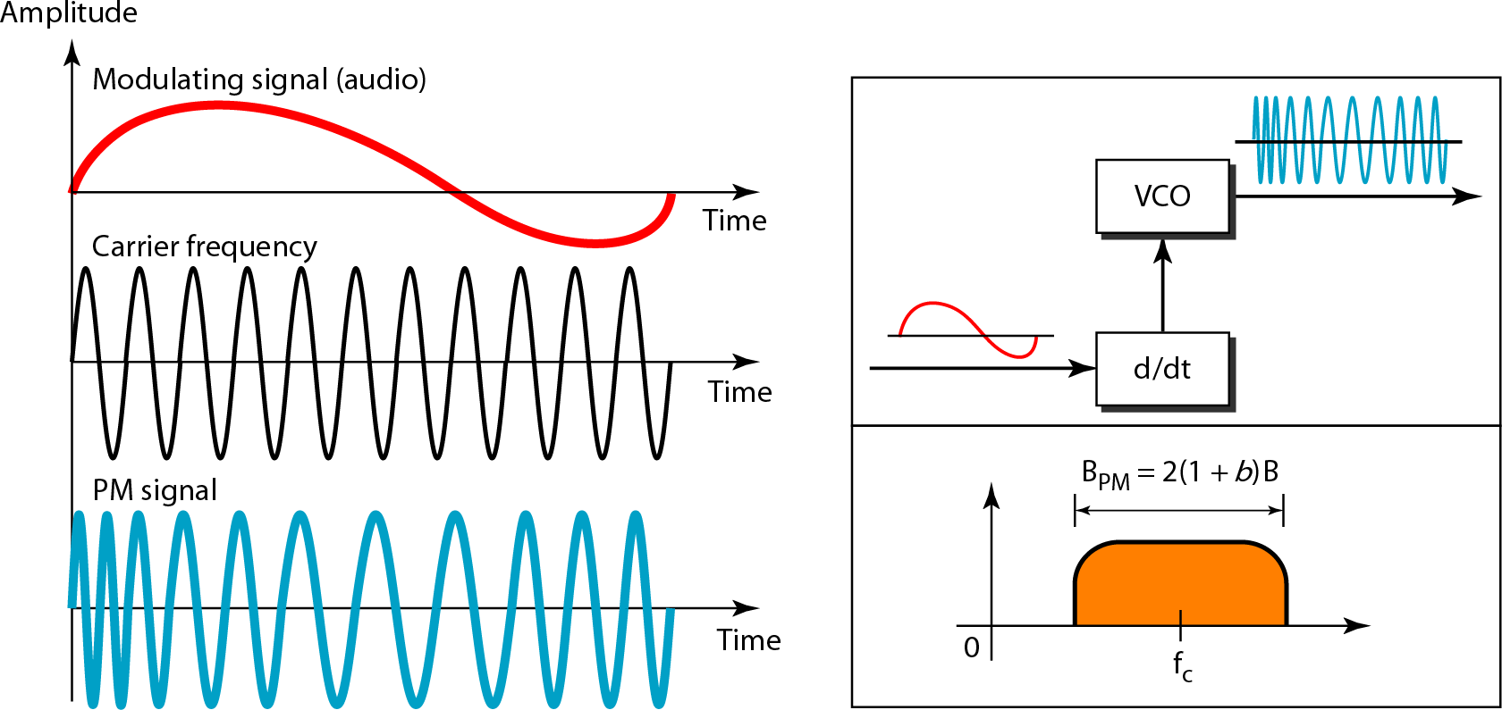
Figure 5.20 Phase modulation

Slide 22


Note
The total bandwidth required for PM can be determined from the bandwidth
and maximum amplitude of the modulating signal:
B_{PM} = 2(1 + β)B.
Where β = 2 most often.

